Slide 1
Renewables 2020 Global Status Report
Prof. Arthouros Zervos
President REN21
14 July 2020

Slide 2
REN21 is an international policy network dedicated to building a sustainable renewable energy future
GOVERNMENTS
Afghanistan, Brazil, Denmark, Dominican Republic, Germany, India, Mexico, Norway, Republic of Korea, South Africa, Spain, UAE, USA
Intergovernmental Organisations
ADB, APERC, ECREEE, EC, GEF, IEA, IRENA, IsDB, RCREEE, UNDP, UN Environment, UNIDO, World Bank
NGOs
Club-ER, CLASP, CCA, CAN-I, Energy Cities, FER, Global 100% RE, GFSE, GWNET, Greenpeace Intl, ICLEI, ISEP, IEC, JVE, MFC, Power for All, REEEP, REI, SCI, SLOCAT, WCRE, WFC, WRI, WWF
Industry Associations
AMDA, ARE, ACORE, APREN, ALER, CREIA, CEC, EHP, EREF, GOGLA, GSC, GWEC, IREF, IGA, IHA, RES4Africa, WBA, WWEA
SCIENCE & ACADEMIA
AEE INTEC, CEEW, Fundacion Bariloche, Higher School of Economics (Russia), IIASA, ISES, NREL, SANEDI, TERI

Slide 3
the only global, renewable energy, multi-stakeholder community
The only global community of renewable energy actors from science, academia, NGOs, governments, and industry.
We build upon a decentralized intelligence, ensuring high responsiveness to an ever changing environment.
Our more than 2,000 community members co-operate collecting information, changing norms and debating.
Our annual publications are probably the world’s most comprehensive, crowdsourced reports on renewables.

Slide 4
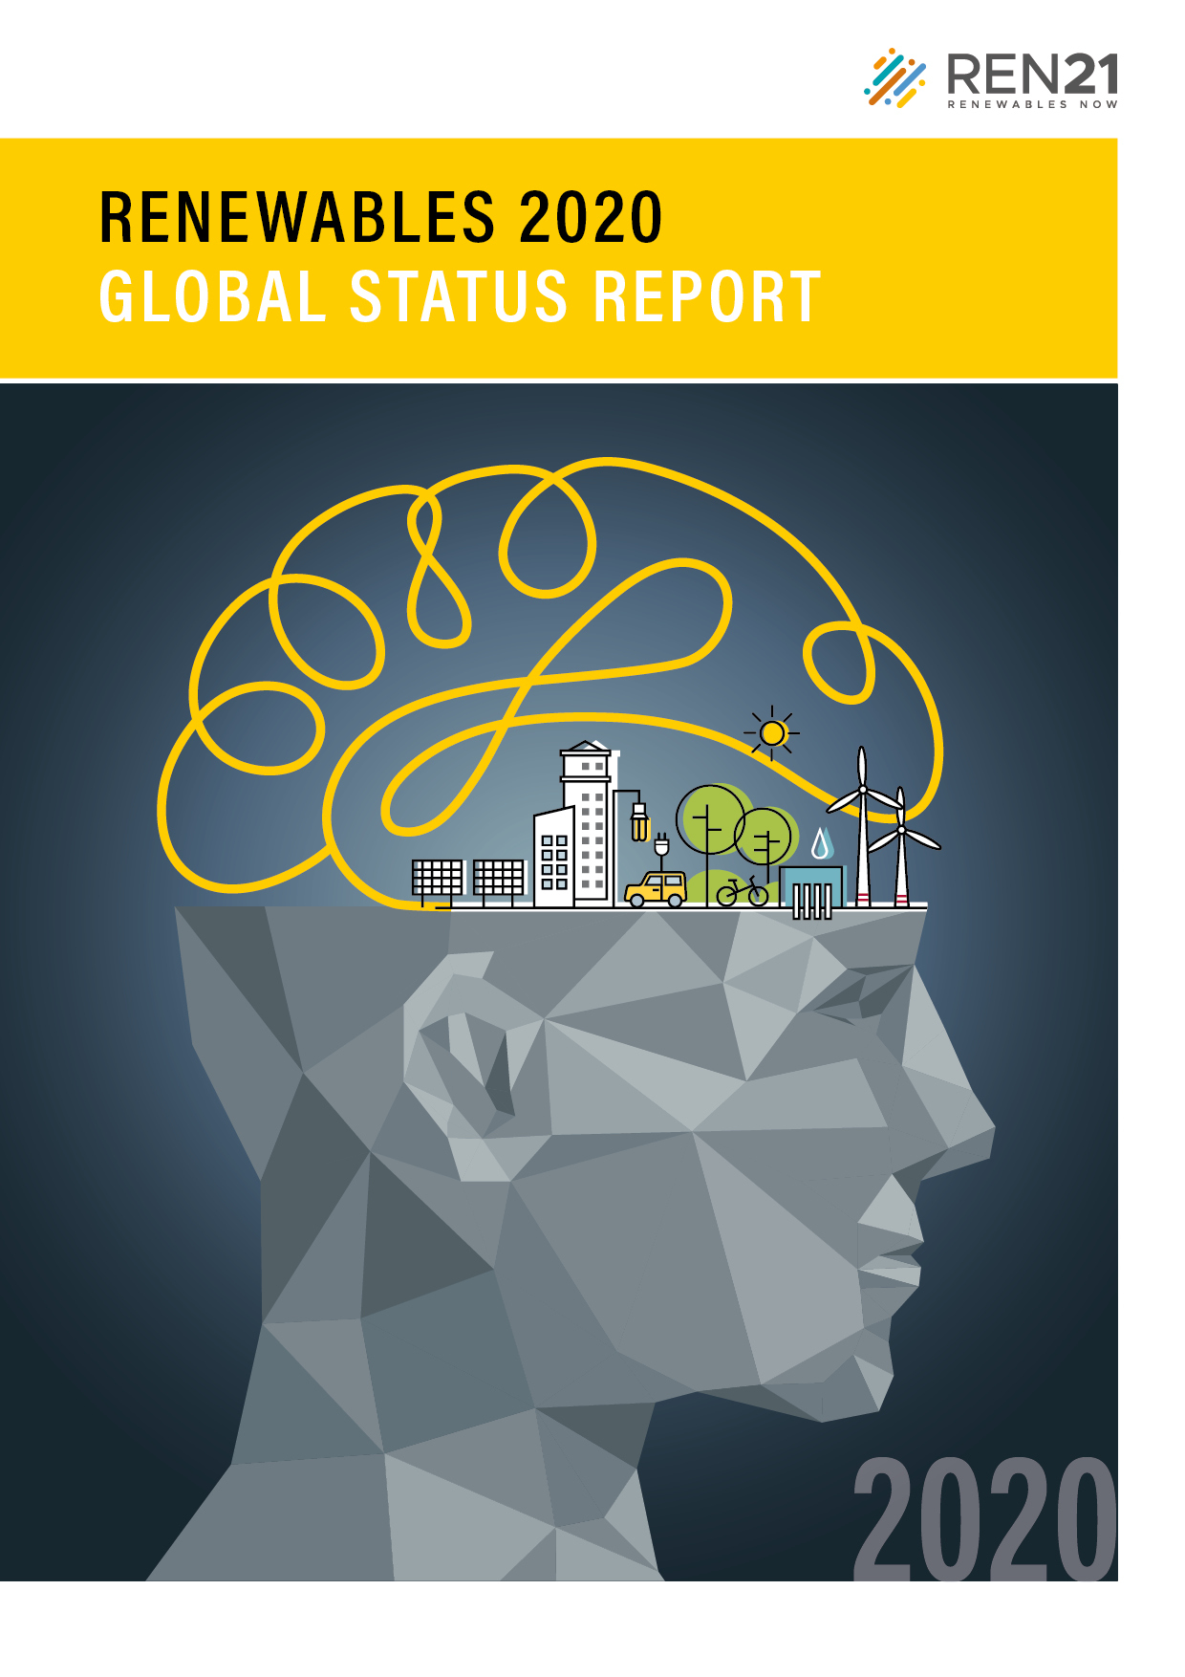
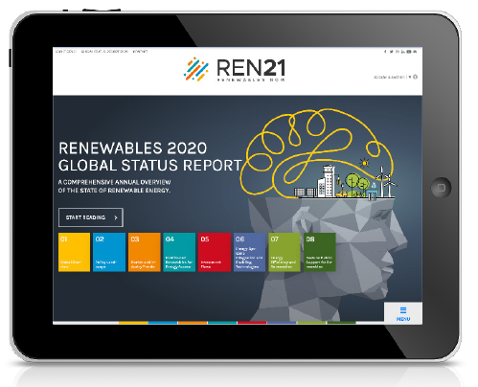
Renewables 2020 global status report
collaborative annual reporting on renewables since 2005
The report features:
Global Overview
Policy Landscape
Market and Industry Trends
Distributed Renewables for Energy Access
Investment Flows
Energy Systems Integration and Enabling Technologies
Energy Efficiency
Feature: Public Support for Renewables
www.ren21.net/gsr-2020
4
Notes:
4

Slide 5
a record 200 gigawatts of renewable power added in 2019
Annual Additions of Renewable Power Capacity, by Technology and Total, 2013-2019
Most of the additions were from solar PV (115 GW), but global markets for wind power and bio-power also grew during 2019.
Notes:
Total capacity
2588 including hydropower
1437 excluding hydropower
More than 200 GW of new renewable power generating capacity was installed in 2019 (growth: 8.4%)
57% of renewable power capacity additions were of solar PV
30% wind power
8% hydropower
Installations were well above 2018 levels, maintaining the more than 8% average growth rate of installed renewable power capacity over the previous five years
Added in 2019:
115 GW of solar PV (total installed capacity growth: 22.5% / annual addition growth: 12% [103 GW in 2018]. Key drivers: cost-competitive (incl. solar+storage), growth in emerging markets, feed-in tariffs (although non-subsidised PV is growing)). Big decline in China (32% - policy uncertainty. No clarity following removal of approval for new subsidised projects in May 2018). Not including China, the global market for solar PV grew about 44% in 2019.
Asia: half of all global PV additions despite declines in top-3 markets (China, India, Japan). Vietnam added 4.7 GW to reach 4.8 GW – feed-in policy expired at the end of 2019.
60 GW of wind power (total installed capacity growth: 10.2% / annual addition growth: 18% [51 GW in 2018]. Key drivers: surges in China and US due to favourable policy. Some emerging markets struggled due to delays in public tenders and policy uncertainty.)
Offshore wind made up a record 10% of 2019 wind additions.
Asia: also more than half of global wind power additions. China and India markets both grew.
16 GW of hydropower (total installed capacity growth: 1.3% / annual addition contraction: 20% [20 GW in 2018]. Brazil added most capacity, first time since at least 2004 that China did not add the most. Drivers: countries are constrained by available resources, including areas restricted for ecological or social reasons)
Asia: Brazil took the lead in commissioning new hydropower capacity in 2019, followed by four countries in Asia: China, Lao PDR, Bhutan and Tajikistan
For the fifth year in a row, net additions of renewable power generation capacity clearly outpaced net installations of both fossil fuel and nuclear power capacity combined

Slide 6
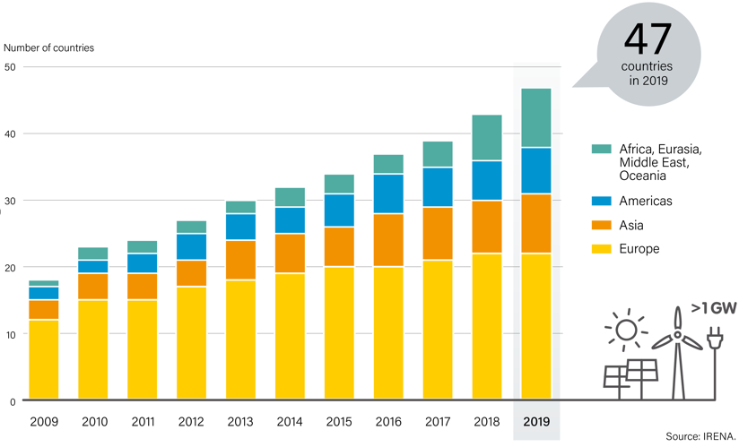
Solar pv and wind power are spreading around the world
Number of Countries with More Than 1 GW of Solar PV and Wind Power, by Region, 2009-2019
47 countries had installed at least 1 GW of solar PV and wind power. compared to 18 countries in 2009.
Notes:
47 countries had installed at least 1 GW of solar PV and wind power. compared to 18 countries in 2009.
By the end of 2019, at least 32 countries had more than 10 GW of renewable power capacity (including hydropower) in operation, up from 19 countries in 2009.
The shift is even more impressive when excluding hydropower, as markets for both solar PV and wind power have grown dramatically in recent years.
At least 17 countries had more than 10 GW of non-hydropower renewable capacity at the end of 2019, up from 5 countries in 2009.

Slide 7
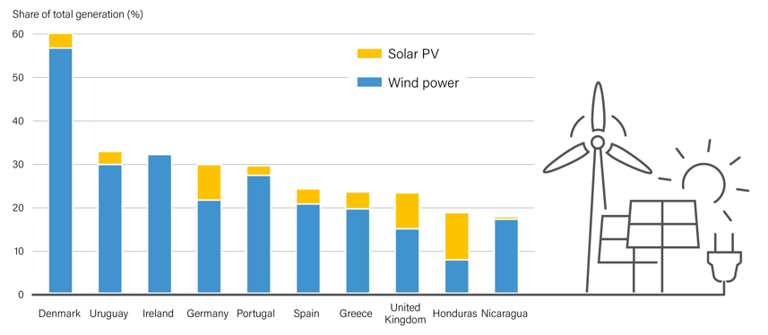
Variable renewables reaching high shares in many countries
Share of Electricity Generation from Variable Renewable Energy, Top Countries, 2019
At least four countries met more than 30% of their electricity generation from VRE in 2019 including Denmark, Germany, Ireland and Uruguay.
Notes:
Rapid growth in the installed capacity and penetration of variable renewable electricity (VRE) sources – such as solar photovoltaic (PV) and wind power – has occurred in many countries.
At the end of 2019, renewables produced an estimated 27.3% of global electricity generation, 8.7% of which was from VRE.
At least four countries met more than 30% of their electricity generation from VRE in 2019: Denmark, Germany, Ireland and Uruguay.
Challenge in improving power system flexibility:
market design to reward flexibility
procurement of flexibility services (generation, demand and storage)
improved forecasting of electricity demand and VRE generation
grid expansion
Asia: while there is not Asian countries in the top ranking, several countries are making progress.
the state-owned Power Grid Corporation of India announced plans for USD 1.8 billion of new transmission projects in several Indian states to support 25.4 gigawatts (GW) of planned wind and solar power projects.
Significant investments in enhanced transmission infrastructure have occurred in China – including the completion of 22 ultra-high-voltage transmission lines in the past decade, motivated in part by the need to accommodate more renewable generation. In addition, China completed in, June 2020, construction of a 22.6 billion yuan ($3.17 billion) ultra-high voltage electricity line that for the first time will transport only “clean” energy.
Outside of Europe, Singapore fully liberalised its retail electricity market in 2019, enabling distributed energy resources to provide flexibility services (which is not focusing on RE only though).

Slide 8
More renewable power added than fossil fuel and nuclear
Renewable and Non-renewable Shares of Net Annual Additions in Power Generating Capacity, 2009-2019
For the fifth year in a row, net additions of renewable power generation capacity were higher than net installations of both fossil fuel and nuclear power capacity combined.
Notes:
In 2019, 75% of global power capacity additions were renewable
For the fifth year in a row, net additions of renewable power generation capacity clearly outpaced net installations of both fossil fuel and nuclear power capacity combined.
2011 was the last year that clearly more non-renewable capacity was added than renewable.

Slide 9
more than 27% of global electricity is now renewable
Estimated Renewable Energy Share of Global Electricity Production, End-2019
The share of renewables in electricity generation is rising in many countries around the world.
Notes:
Renewables supplied an estimated 27.3% of global electricity at the end of 2019.
Variable renewables (solar PV and wind power) reached a combined 8.7%, up from estimated 7.8% in 2018.
Strong growth in renewable generation, but rising electricity demand makes it challenging to achieve larger share.
Renewable electricity shares are rising rapidly in many countries and regions.
Change from 2009-2019. EU: 19% to 35%; Denmark: 39% to 77%; Germany: 16% to 42%; UK: 8% to 38%; US:10.2% to 17.4%; China: 16.6% to 26.4%, despite a more than doubling of total electricity production during the decade.

Slide 10
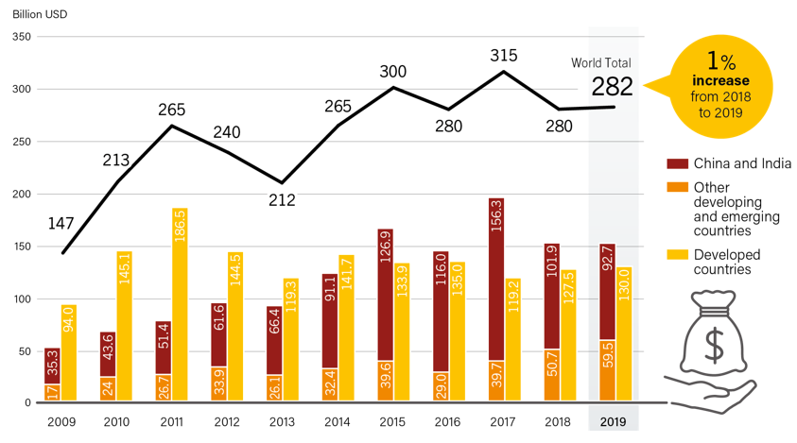
Investment in renewableS has barely grown
Global Investment in Renewable Power and Fuel Capactiy in Developed, Emerging and Developing Countries, 2009-2019
Developing and emerging economies surpassed developed countries in renewable energy capacity investment for the fifth year running, reaching USD 152 billion.
Notes:
Global investment in renewable power and fuels (not including hydropower projects larger than 50 megawatts, MW) totalled USD 301.7 billion in 2019.
If we consider investment in new capacity only, which accounted for much of the 2019 total, amounts invested reached USD 282.2 billion, only 1% more than in 2018.
Nevertheless, Investment in renewable power capacity (including all hydropower) was three times the level of investment in coal, natural gas and nuclear generating capacity combined in 2019.
Developing and emerging economies outweighed developed countries in renewable energy capacity investment for the fifth year running, accounting for 54% of the total in 2019, due largely to China
It is interesting to note that investment grew quickest in developing and emerging countries rising 17% if we do not include China and India.

Slide 11
renewable power Costs keep falling
Global Levelised Cost of Electricity from Newly Commissioned, Utility-scale Renewable Power Generation Technologies, 2010-2019
Costs for solar PV and CSP as well as onshore and offshore wind have fallen sharply over the past decade.
Notes:
Costs for solar PV and CSP as well as onshore and offshore wind have fallen sharply over the past decade
Between 2010 and 2019, the global weighted average LCOE of commissioned projects fell 13% for bio-power, 29% for offshore wind power, 39% for onshore wind power, 47% for CSP and a precipitous 82% for solar PV

Slide 12
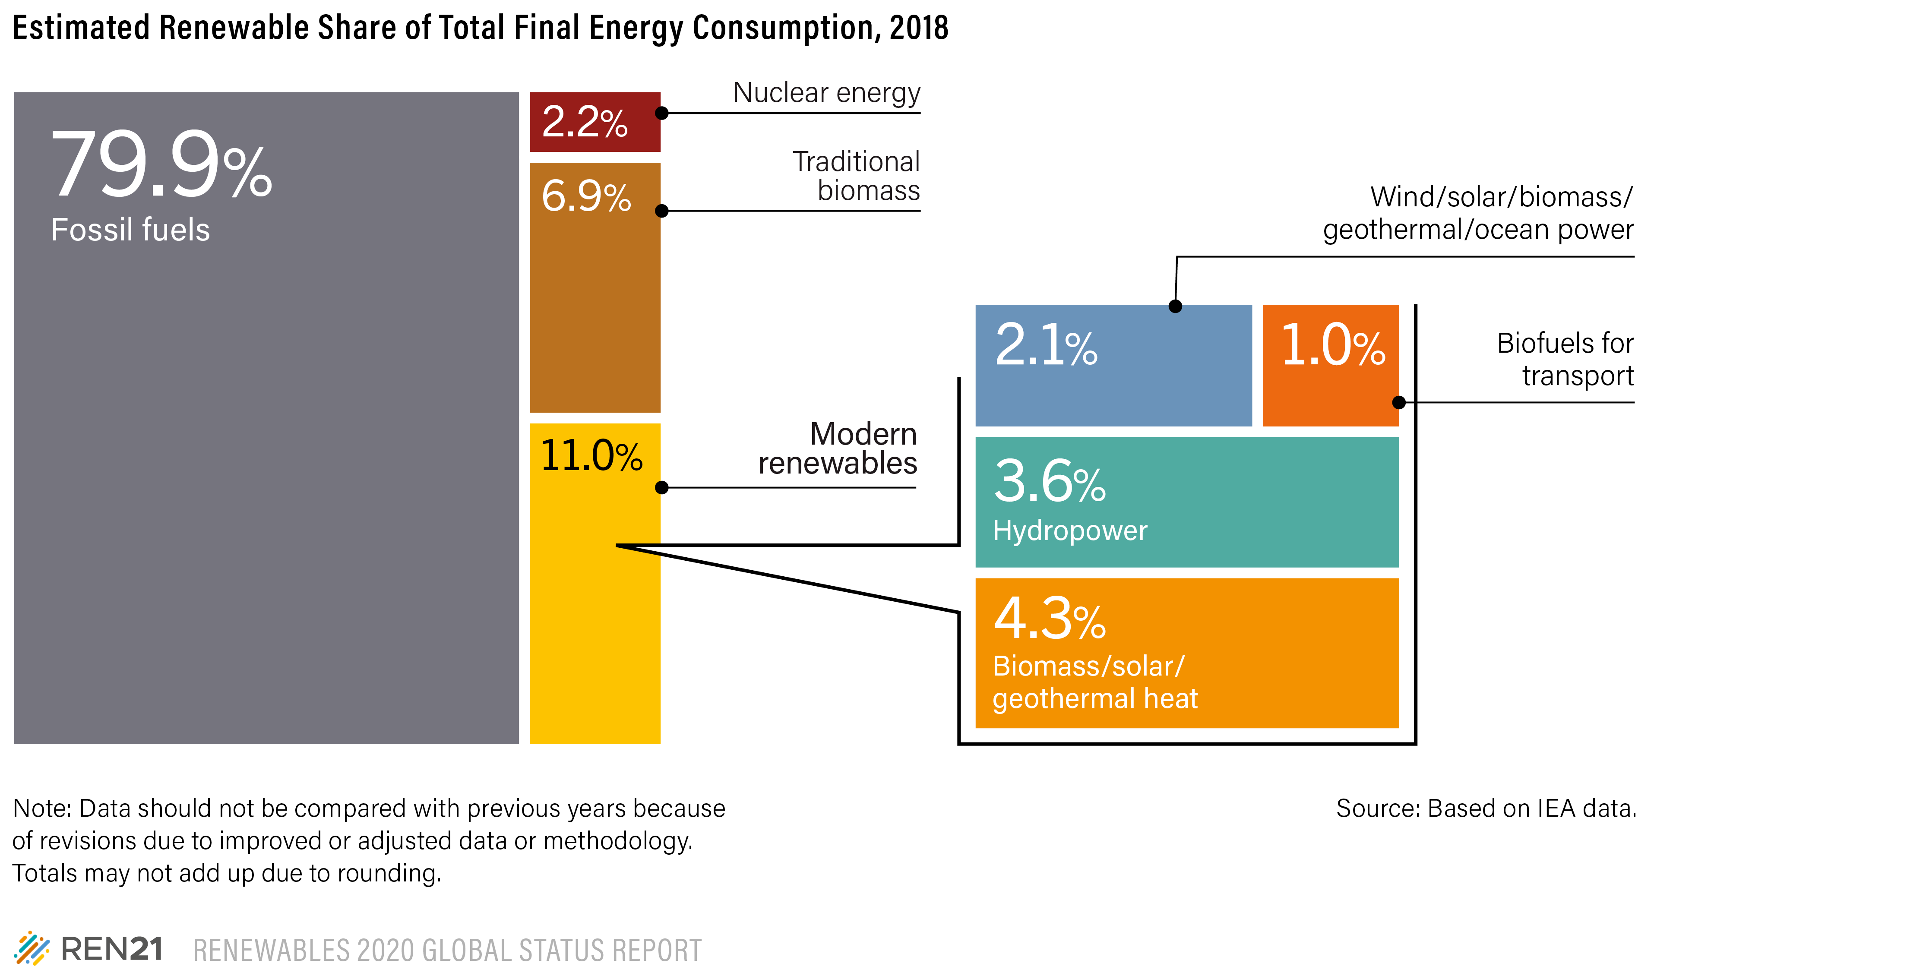
only moderate change in renewable share of energy demand
Estimated Renewable Share of Total Final Energy Consumption, 2017
Renewable share grew from 9.6% in 2013 to only 11% in 2018.
Notes:
Modern renewable energy accounted for 11% of final energy demand in 2018. Increase from 9.6% in 2013.
Renewable electricity covered 5.7% of final energy, modern renewable heat 4.3% and transport biofuels 1%.

Slide 13
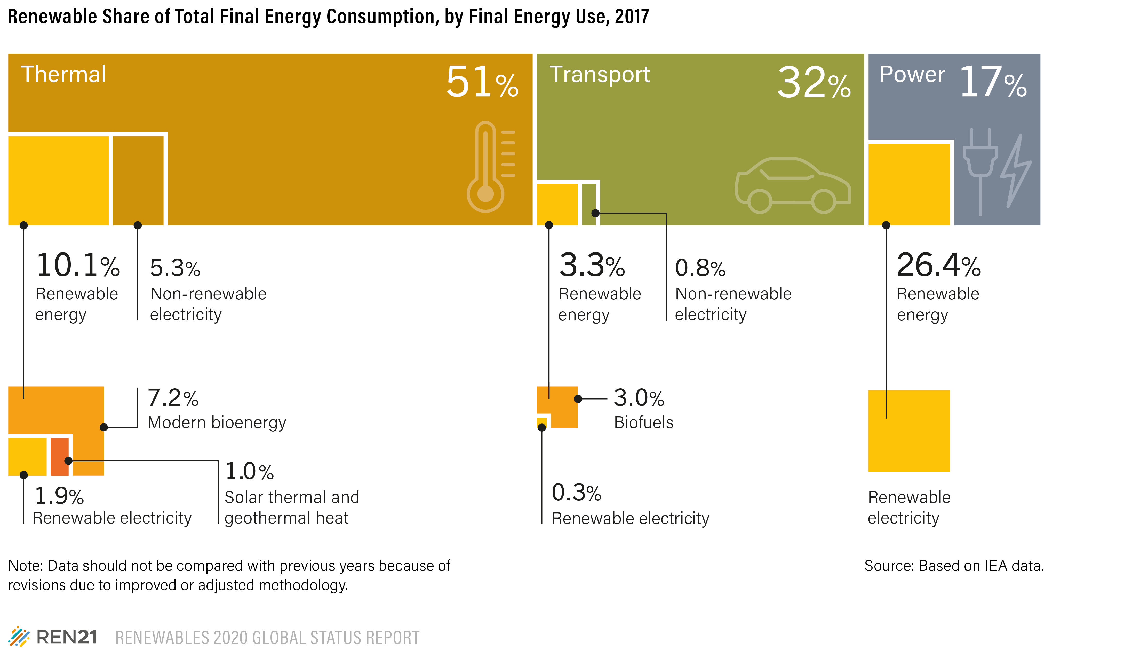
more than 80% of our energy for heating, cooling, transport
Share of Electricity Generation from Variable Renewable Energy, Top Countries, 2019
Most focus is on the power sector.
But the greatest urgency is in heating, cooling and transport.
Notes:
Over half of final energy demand is from the heating and cooling sector
10.1% of this demand is supplied by renewable energy
32% of final energy demand is for transport end-uses
Just over 3% is renewable and primarily met by biofuels
Renewable electricity still plays a small role
Around 26% of power demand was renewable

Slide 14
renewables still meet low share of thermal energy needs
key barriers
Sector heavily relying on fossil fuel
fossil fuel subsidies – no level playing field
Upfront capital cost of RE
Lack of supportive regulatory framework
No new H&C policies since 2017
No support for electrification
Resource availability –
Investments in supporting infrastructure needed (e.g., district heating and cooling)
Technological advances needed for high-temperature industrial processes
Notes:
Upfront capital cost (heat pumps, solar thermal) vs. FF options – policies still exist that support gas boiler replacement. → FF subsidies and carbon tax are important here.
Resource availability (bioenergy, solar thermal, geothermal) → need supply chains and infrastructure (DHC+storage) to distribute renewable heat in urban areas
Lack of supportive regulatory framework developments on support policy (number of heating policies has not increased since 2017)
Renewable hydrogen needed for high-temperature industrial processes
Highlights
Bans on some type of fossil fuel heating in buildings in planning/implemented in 5 countries (Austria, Norway, Poland, Germany, UK, Netherlands) → these apply mainly to new buildings and vary depending on oil ban or gas ban. Also: Vienna, Berkeley and Montreal on sub-national level.
Net zero energy buildings are gaining momentum. ”Zero Carbon Buildings For All” initiave was launched in 2019.
Renewable electricity for heat. Sales of heat pumps have grown in US, in Europe, in China and in Japan. Technology costs need to come down and regulatory framework for time-of-us electricity (flexibilty) are needed.

Slide 15
renewables were fastest growing energy source in buildings
Notes:
The buildings sector consumes around one-third of final energy.
Energy use in the sector is growing at around 1% per year – increases in population and building floor area overcome gains in energy efficiency.

Slide 16
Renewable heat is gradually growing in buildings
Estimated Renewable Share of Heating and Cooling in Buildings, 2018
The share of renewable heating and cooling in buildings grew from 8% in 2010 to more than 10% in 2018.
Notes:
77% of final energy demand in buildings is for heating and cooling energy uses.
Total heating and cooling demand has grown slowly (0.6% annually since 2010), although energy used for cooling (around 6% of building energy consumption) – the fastest growing energy end-use in buildings – rose 4% per year between 2010 and 2018.
Bioenergy use for H&C in buildings has remained stable as bio-heat consumption has grown at the same rate as building heat demand.
The use of renewable electricity for heat in buildings is growing rapidly (5.3% per year).
The share of renewable electricity for heat grew from 2% in 2010 to 3% in 2018.
Solar heat and geothermal use have also grown quickly, though starting from a small base.

Slide 17
The share of renewables in transport has not changed
key barriers
Sector heavily relying on fossil fuel
Fossil fuel “centered” market structures
Fossil fuel subsidies – no level playing field
Exploding demand growth (+4% p.a.)
Lack of strong policy support
no new countries with biofuel blend mandates since 2017
Only nine countries with advanced mandates
Only five countries with fuel economy standards
Limited options in aviation and shipping
Notes:
Exploding demand growth (approximately equivalent to the growth in power and heating combined), coupled with the sector been almost entirely reliant on fossil fuels (nearly 97%). Growth driven mostly by developing and emerging countries, and also the trend toward larger vehicles.
Lack of a strong policy support: no new countries have adopted Biofuel blend mandates since 2017 (70), blending mandates typically at low levels, no new countries have adopted fuel economy standards since 2017 (37), only five countries had fuel economy standards for trucks, lasting reputation of unsustainable biofuels.
Only nine countries have advanced biofuel blend mandates, 17 countries have advanced Biofuel blending targets – almost all in single digits; relatively high costs and slow developments in advanced Biofuels and renewable Electrofuels
Ongoing fossil fuels subsidies.
Limited options for aviation and shipping; only eight airports have regular distribution of biofuels.
Key highlights:
The private sector has expanded its efforts on renewables across all transport modes, including new mobility services – both in biofuels and renewable-powered electric vehicles
The international maritime organization agreed to stricter efficiency targets and new fuel and emission standards. Some shipping companies in Scandinavia agreed to use LBG, while trials began on using ammonia as a shipping fuel.
Four new ports joined the world ports climate action program (11 total), while other ports also have committed to Decarbonising (e.g. port of Houston).
Finland adopted a 30% biofuel target for aviation. New taxes were adopted to discourage air travel (e.g. in France and Germany) with proceeds going to lower carbon modes. Eight more member states of the international civil aviation organization submitted state action plans (119 total) to support the production and use of sustainable alternative aviation fuels.
The European Union developed the first ever emissions standards for trucks.

Slide 18
Electric car stock increased 40% in 2019
Electric Car Global Stock, Top Countries and Rest of World, 2015-2019
Share of electric cars in new car sales reached 2.5%, a record high.
Notes:
The stock of electric cars (passenger EVs) increased 40% in 2019, up more than 2 million from 2018.
Growth was lower than in 2018, when 2.2 million of the vehicles were sold and the global stock jumped 63% over the previous year
In 2019, electric cars still comprised only a small share of all passenger vehicles, at just 0.6% of the global stock.
Share of electric cars in new car sales reached 2.5%, a record high.
China was home to 47% of the global electric car stock by the end of 2019, followed by Europe (25%) and the United States (20%).
Norway remained the leader in the share of electric cars in overall car sales, at 56%, followed by Iceland (25%), the Netherlands (15%) and Sweden (11%).
Variable renewable electricity was increasingly supplied to EV charging networks in 2019.

Slide 19
Power sector continues to receive most policy attention
Number of Countries with Renewable Energy Policies, 2004-2019
Policies and targets renewables in power remain more ambitious and more numerous than those for other sectors.
Notes:
At least 68 renewable energy auctions or tenders were held across at least 41 countries at the national or state/provincial level, down from 48 countries in 2018
FITs in place in 87 countries
No new countries adopted biofuels mandates, but 6 countries revised their biofuel blend mandates
No new countries adopted H&C regulatory policies

Slide 20
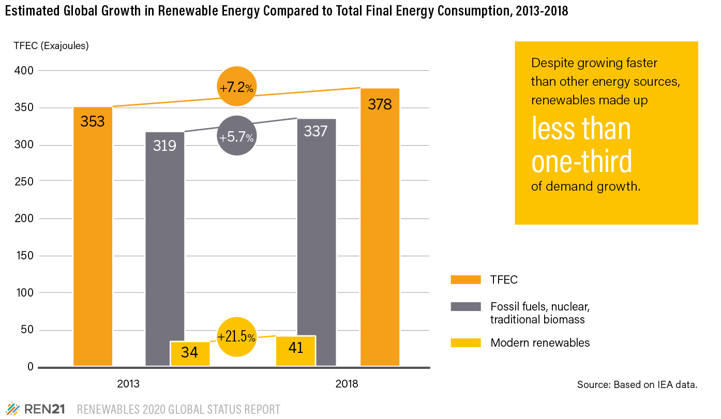
renewables are growing fast... but not fast enough
RISING ENERGY DEMAND KEEPS RENEWABLE SHARE LOW
Renewables grew three times faster than fossil fuels
Renewable energy only accounted for 29% of demand growth
Energy efficiency and renewables both needed to reduce fossil fuel use
Notes:
The slow increase in the share of renewables has occurred despite tremendous growth in some renewable energy sectors.
Total demand for modern renewables grew strongly (7.3 exajoules, EJ) between 2013 and 2018, rising around 4.0% annually.
Nearly half of this growth (48%) was due to consumption of electricity from wind power and solar PV.
During the 2013-2018 period, TFEC grew 25.3 EJ, or around 1.4% annually.
Thus, renewable energy increased at nearly three times the rate of TFEC, accounting for 29% of the total increase in energy demand.
However, this means that other energy sources (predominantly fossil fuels, growing at a rate of 1.3% annually) accounted for 71% of the total increase in energy demand, highlighting the challenge that renewables faced in gaining greater TFEC shares during the five-year period.
This slow progress points to the complementary roles of energy eﬀiciency and renewables in reducing the contributions of fossil fuels in meeting global energy needs

Slide 21
www.ren21.net

